Slide 1


Photon Counting Interferometry to Detect Geotropic Space-time Fluctuations with GQuEST
Daniel Grass

Slide 2
Quantum Mechanics and General Relativity
Quantum Mechanics and General Relativity make very accurate predictions in their own realms
These two theories are incompatible
Many theories exist, like String Theory, LQG, etc, but either don’t make testable predictions or their predictions have not been supported by experiment
Holographic quantum gravity theories point to detectable spacetime fluctuations

Slide 3

The Proposed Signal
Spacetime Metric modified with a scalar field
Important Features: low amplitude, high frequency, stochastic, and has medium-range spatial correlations

Slide 4
Problematic for 3rd Generation GW Detectors
Bub et al., 2023

Slide 5
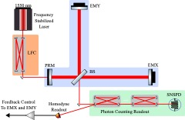
The Detector

Slide 6
What if we could build a detector limited by classical noise instead of shot noise?
Notes:
Noise budget
Shot noise, purple dotted line, way above signal
Classical noise near signal

Slide 7
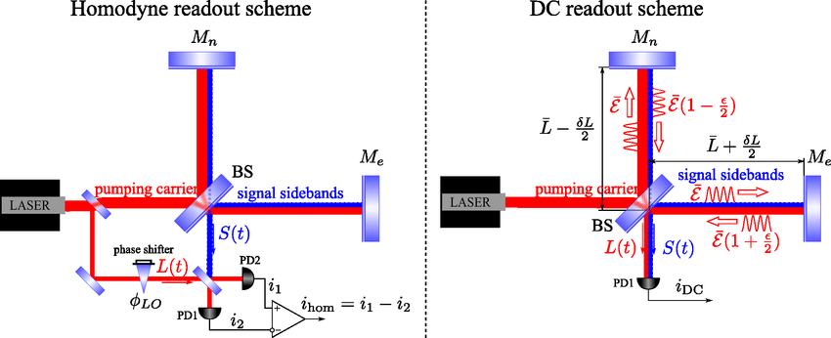
Problems with Homodyne
Homodyne is used in LVK detectors to sense amplitude and phase
However, for excess power measurements, Homodyne is no longer optimal
Homodyne readout’s sensitivity is limited by the shot noise
What is a better readout scheme for excess power measurements?
Danilishin & Khalili, 2012
Notes:
James Gardner next

Slide 8
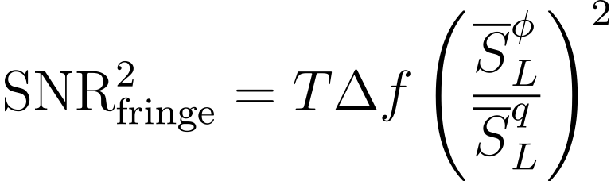
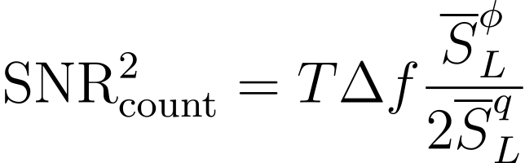
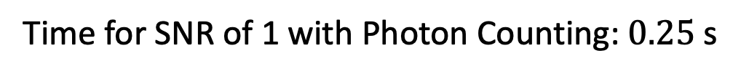
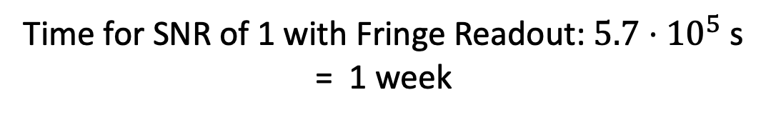
Photon Counting
Consider an interferometer with no classical noise operated perfectly at the dark port
All photons are signal photons!
Much shorter integration time
Time for SNR of 1 with Fringe Readout: $5.7⋅{10}^{5}$ s
= 1 week
Time for SNR of 1 with Photon Counting: $0.25$ s

Slide 9
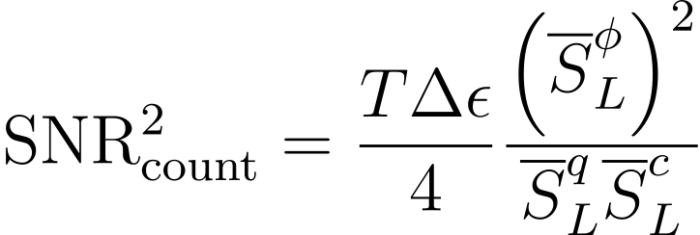
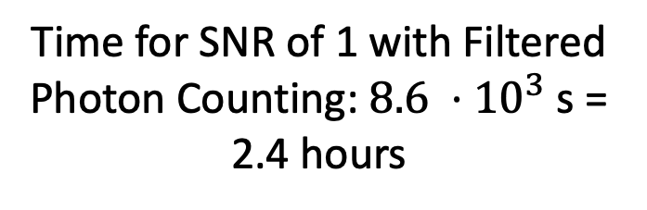
But there is carrier light and classical noise
An interferometer can’t be operated at the dark fringe
Conditions of a perfect interferometer can be mimicked with a series of narrow optical band pass filters
Time for SNR of 1 with Filtered Photon Counting: $8.6 ⋅{10}^{3}$ s = 2.4 hours
Notes:
James Gardner’s talk will follow mine

Slide 10
GQuEST Configuration
5 m
Using a power-recycled Michelson interferometer
Photon counting readout scheme
Can still collect data with homodyne readout and use it for feedback control
10 W input, 10 kW circulating power, 100 mW output power
1550 nm light for use with Silicon Optics

Slide 11
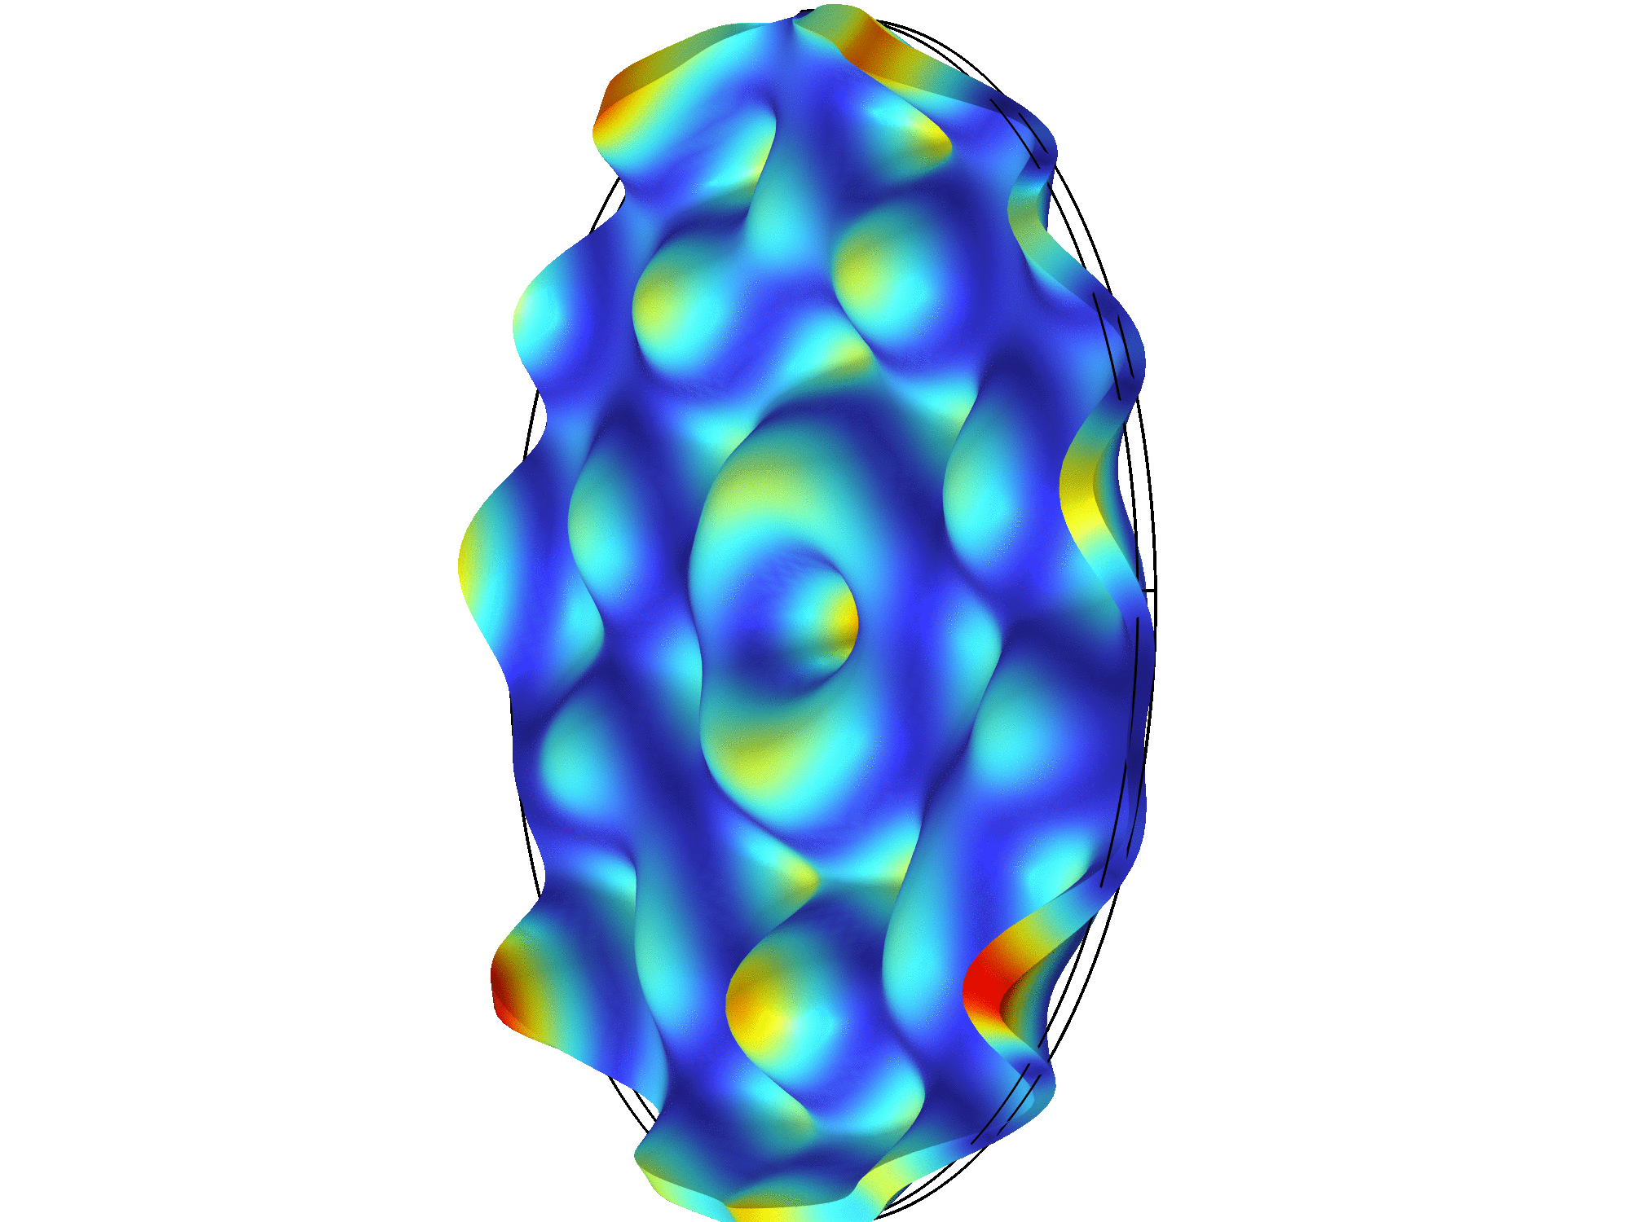
Noise Budget
Dominated by thermal noise from the optics: coating and bulk
To reduce bulk noise, use thin, stiff, and high Q optics
High thermal conductivity desirable to limit thermal lensing
Silicon: stiff, high Q, high thermal conductivity
Notes:
Go through noise sources
Mention that we aren’t including noises that LIGO has to deal with, like quantum backaction, seismic, or residual gas, but we have modeled them

Slide 12
4 Requirements for Photon Counting
4 Optical Bandpass Filters with 22 orders of magnitude suppression in power
Carrier suppression
Low Dark Count Rate Detector
Low Classical Noise
Small Contrast Defect
Single Photon Detector (SNSPD)
Detector R&D
Excellent Controls and additional R&D

Slide 13
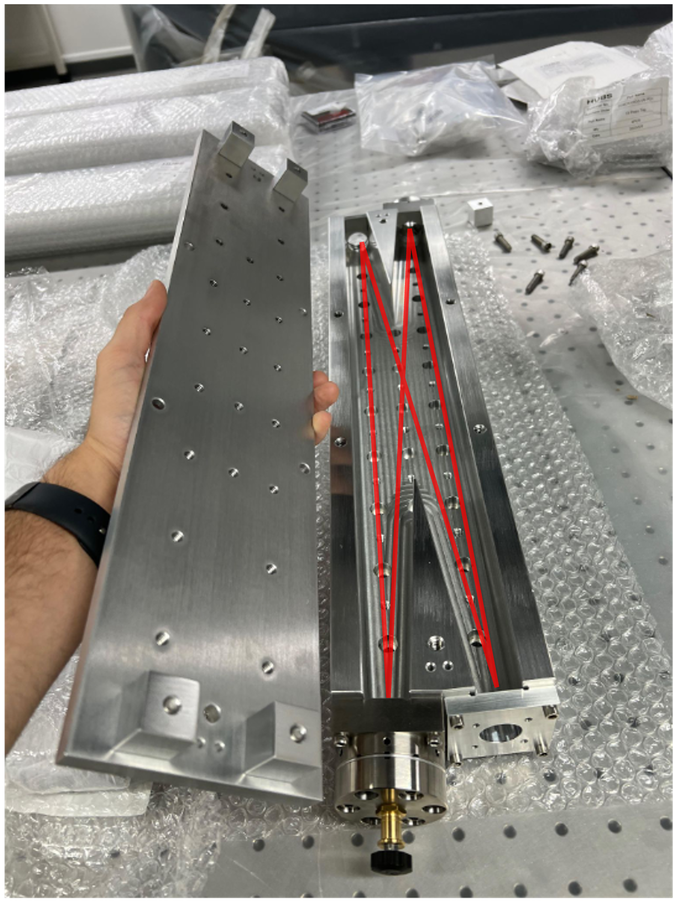
Optical Bandpass Filters
6 orders of magnitude of carrier suppression each
Bowtie Cavity Configuration
4 cavities in total to suppress carrier
Multiple cavities also prevent higher-order spatial modes and frequency modes from leaking through
25 kHz integrated bandwidth
Locked using 775 nm light
Notes:
Say that this mechanically holds the optics

Slide 14
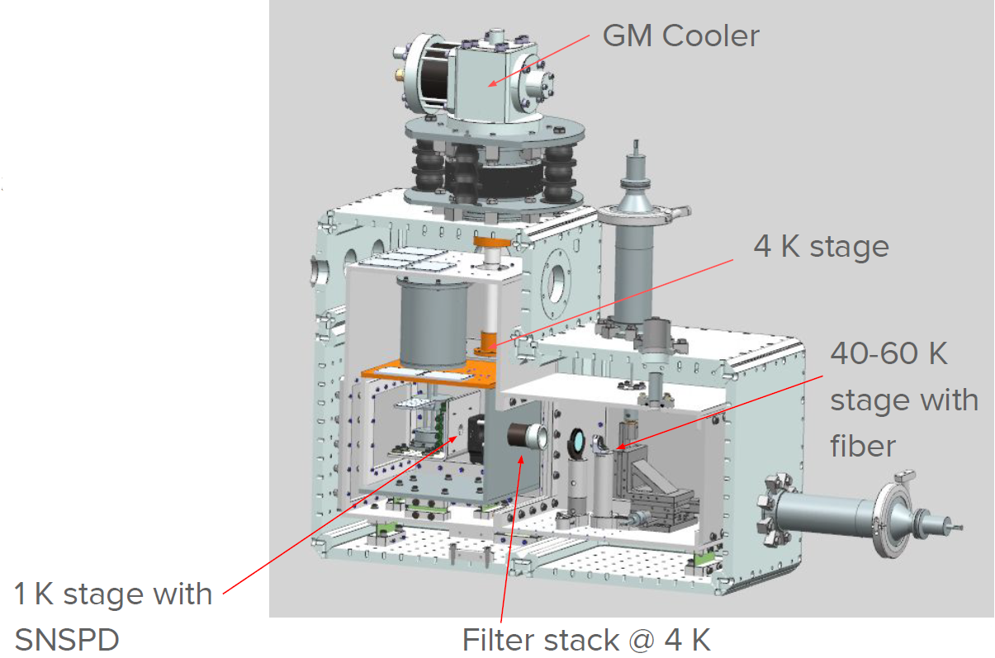
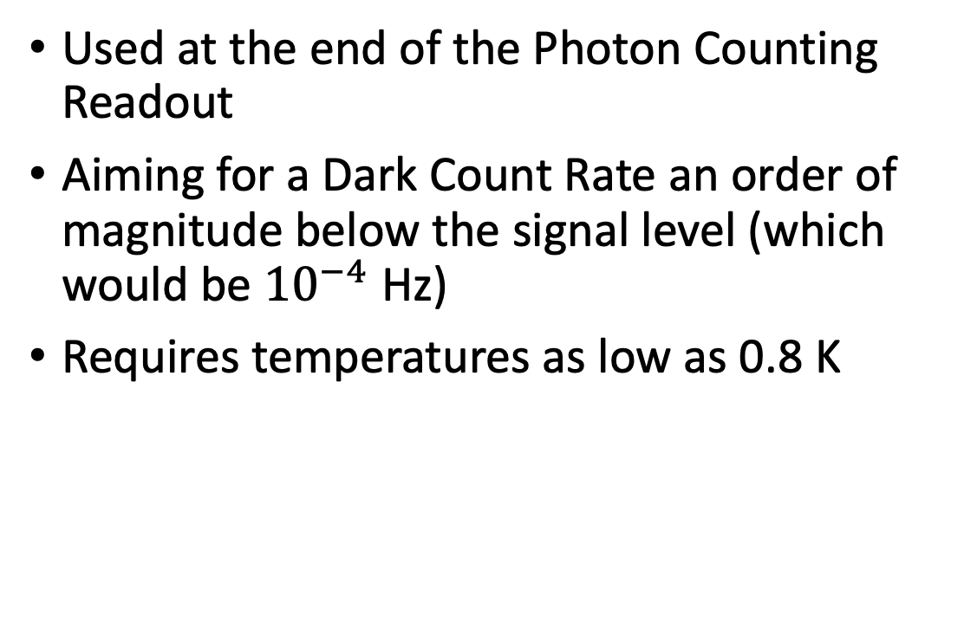
SNSPD: Superconducting Nanowire Single Photon Detector
Used at the end of the Photon Counting Readout
Aiming for a Dark Count Rate an order of magnitude below the signal level (which would be ${10}^{−4}$ Hz)
Requires temperatures as low as 0.8 K

Slide 15
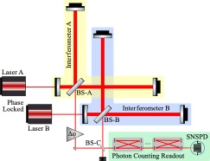
Full GQuEST Configuration
Classical Noise still above Signal
Two phase-locked, co-located Power Recycled Interferometers to cross-correlate
Assuming stationarity of signal and noise, only need one photon counting readout
Can switch whether the output has just noise or signal + noise
Potentially limited by noise at BS-C

Slide 16
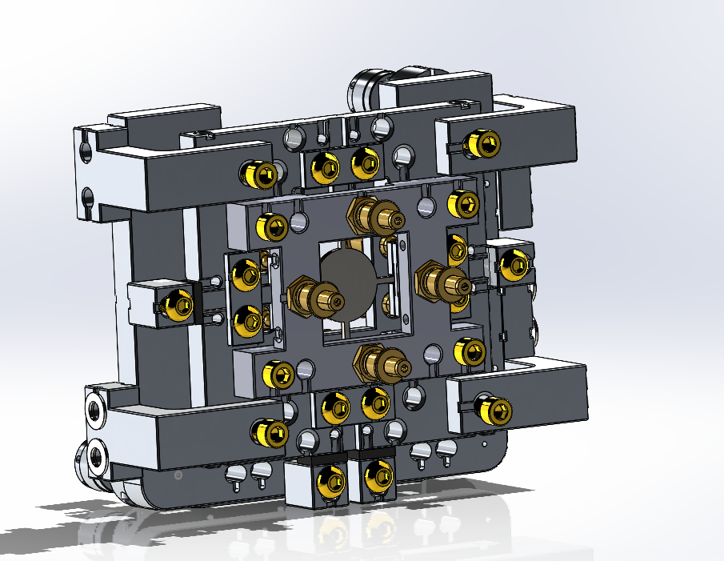
Highlight of other topics
Custom Mirror Mount to hold optics and mode match by correcting for astigmatism
Laser Filter Cavity to reduce laser phase noise and act as a reference for other cavities
Very beginning of work to make bandpass filters with atomic transitions

Slide 17
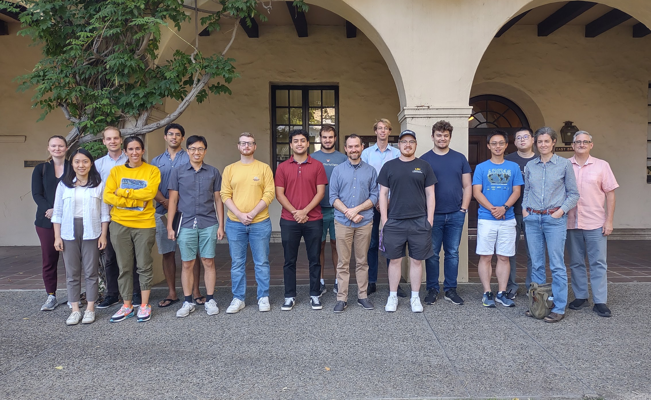

Slide 18
Thank you!

Slide 19
Extra Slides

Slide 20
Spacetime Fluctuations in LIGO
Bub et al., 2023
Notes:
Livingston detector, alpha = 1

Slide 21
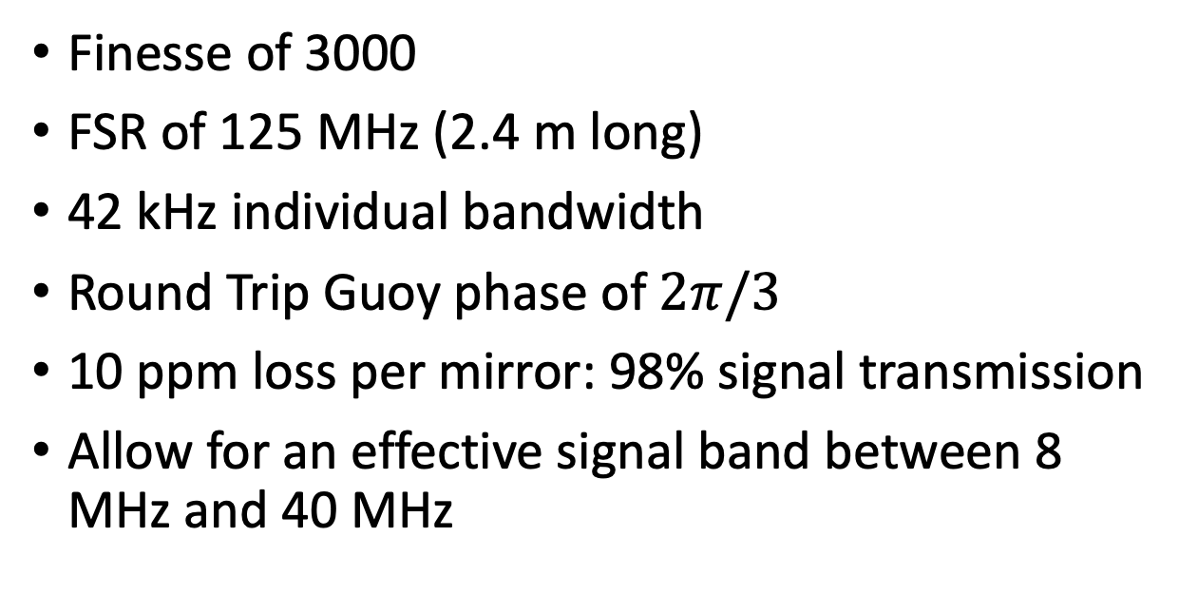
More on Optical Bandpass Filters
Finesse of 3000
FSR of 125 MHz (2.4 m long)
42 kHz individual bandwidth
Round Trip Guoy phase of $2π/3$
10 ppm loss per mirror: 98% signal transmission
Allow for an effective signal band between 8 MHz and 40 MHz

Slide 22
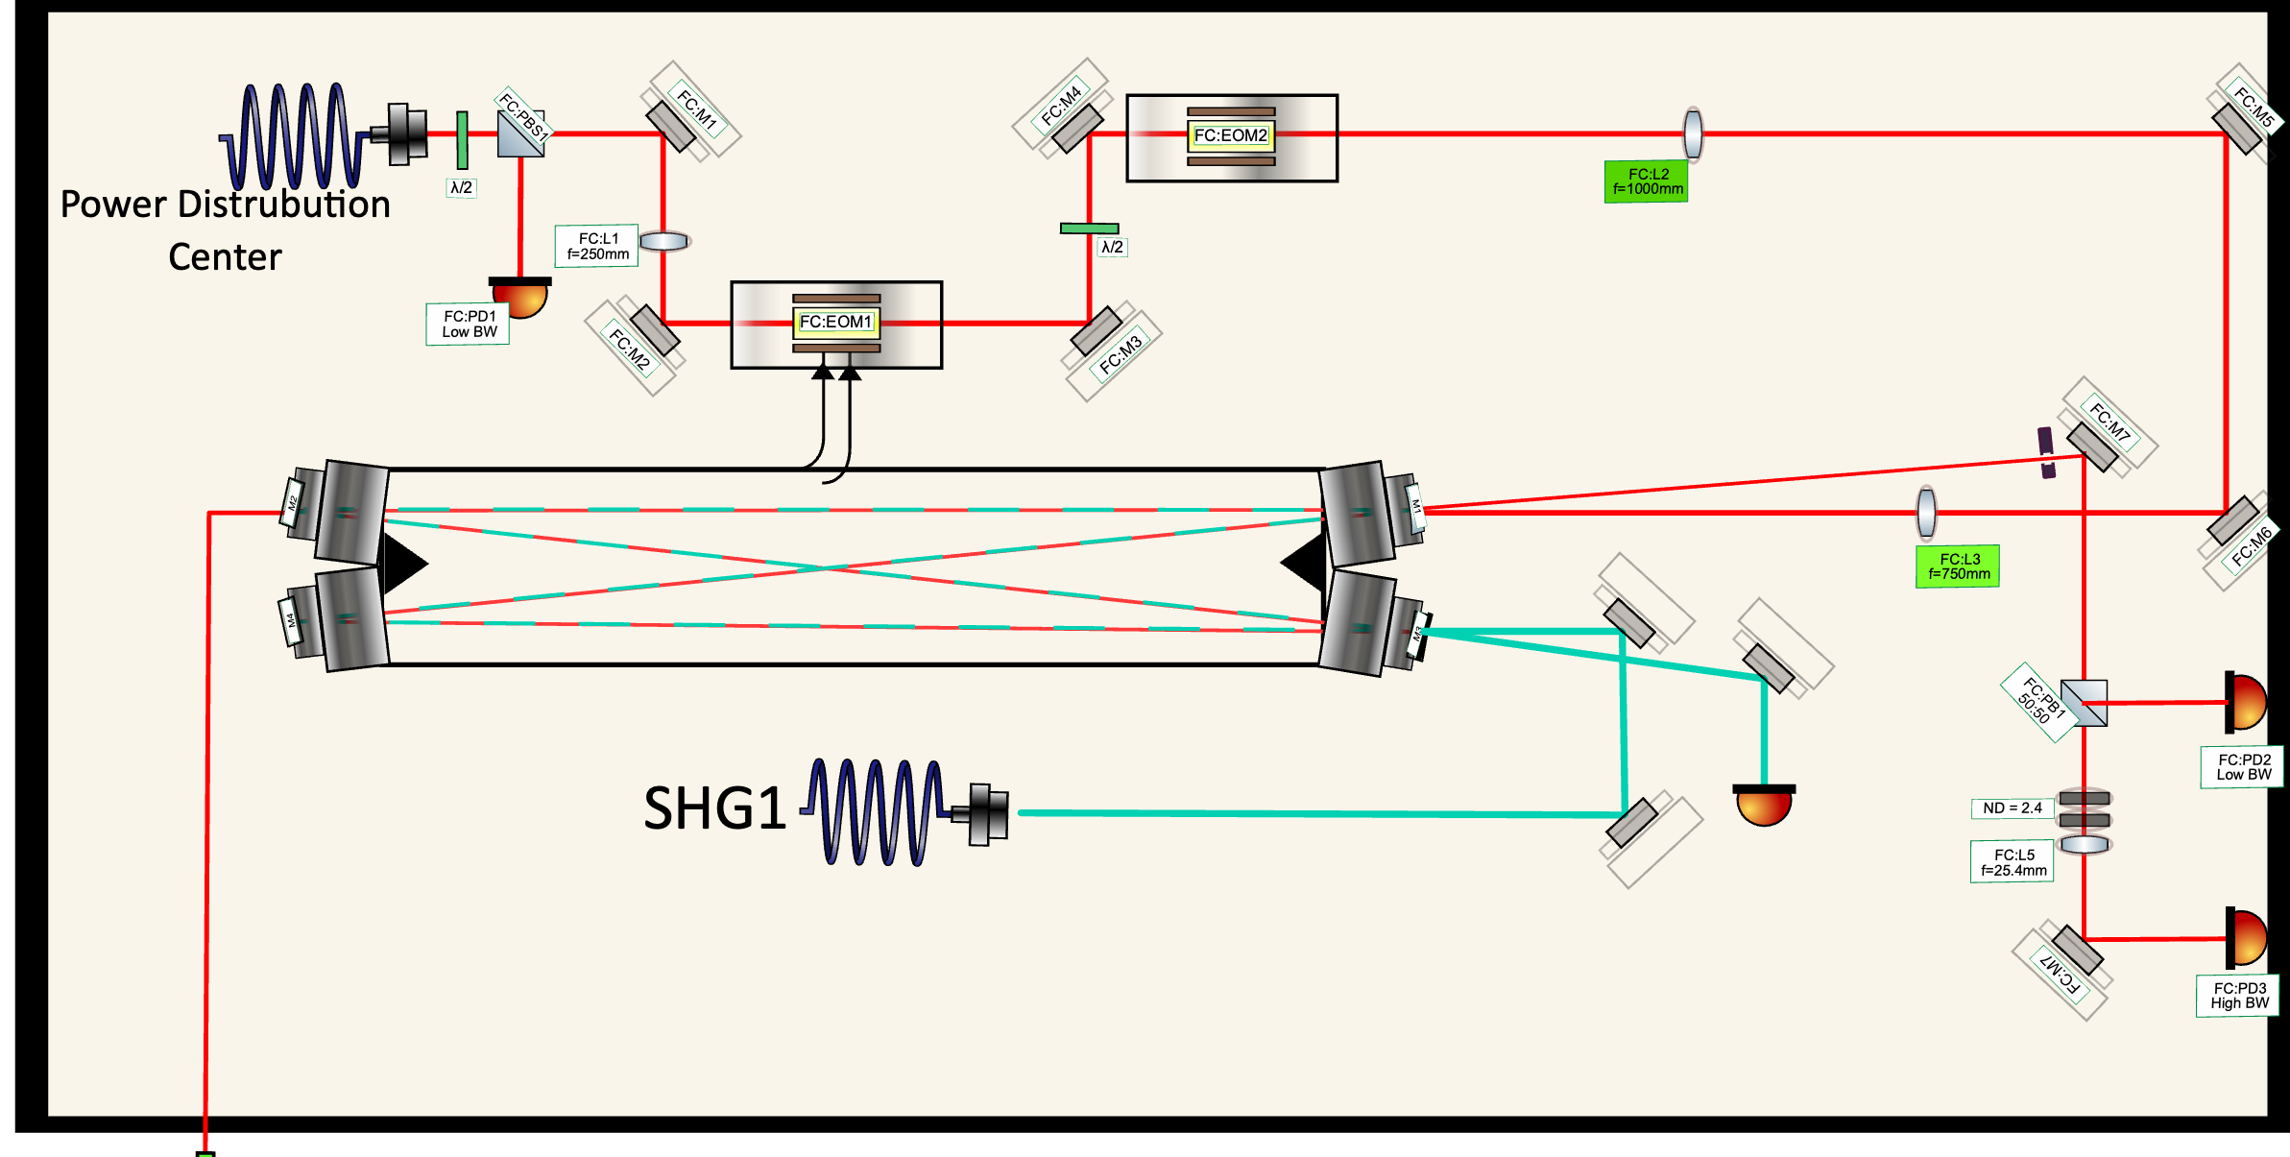
Bowtie Cavity Laser Design

Slide 23
Laser Filter Cavity Justification

Slide 24
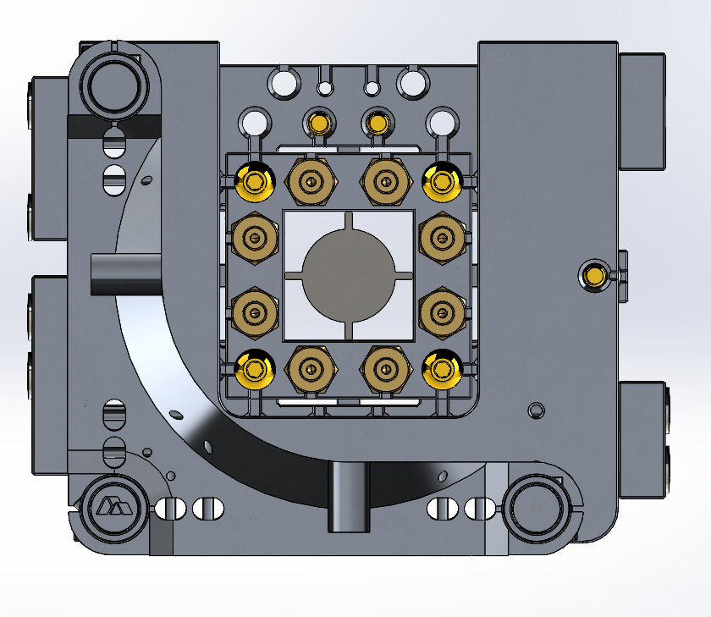
Custom Mirror Mount Design

Slide 25
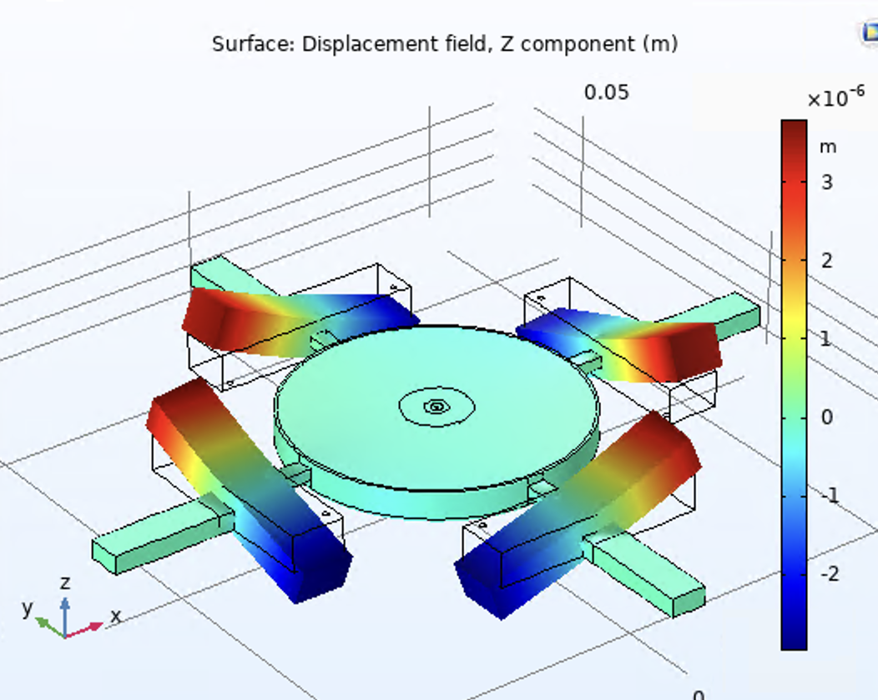
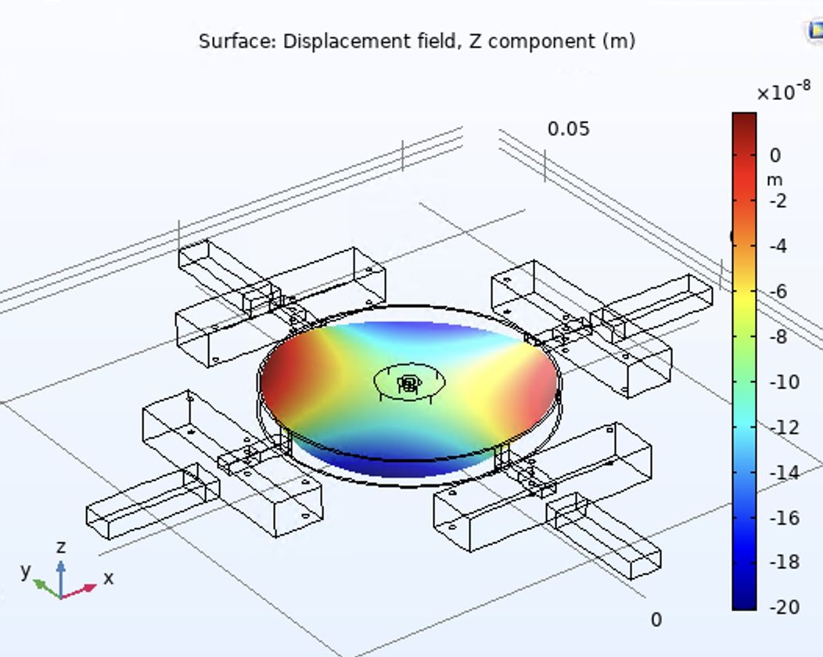
Custom Mirror Mount Simulation

Slide 26
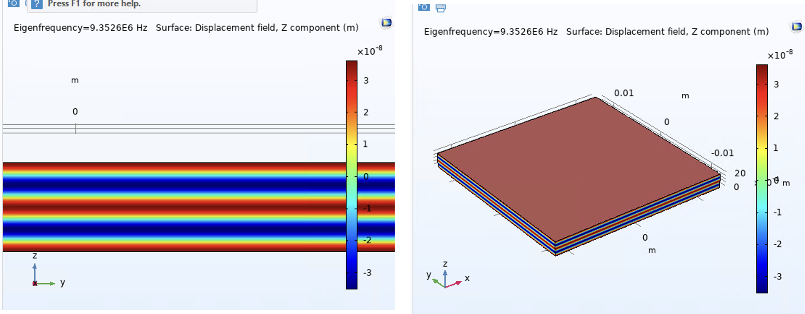
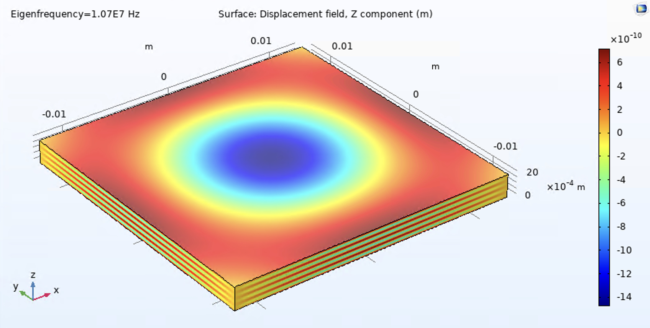
Eigenmode Decomposition Theory
The mirror has (many) eigenmodes
Each eigenmode displaces the mirror surface, which affects the phase of the light and looks like signal
The strength of the noise from each eigenmodes is proportional to the overlap integral of the beam and the eigenmode

Slide 27
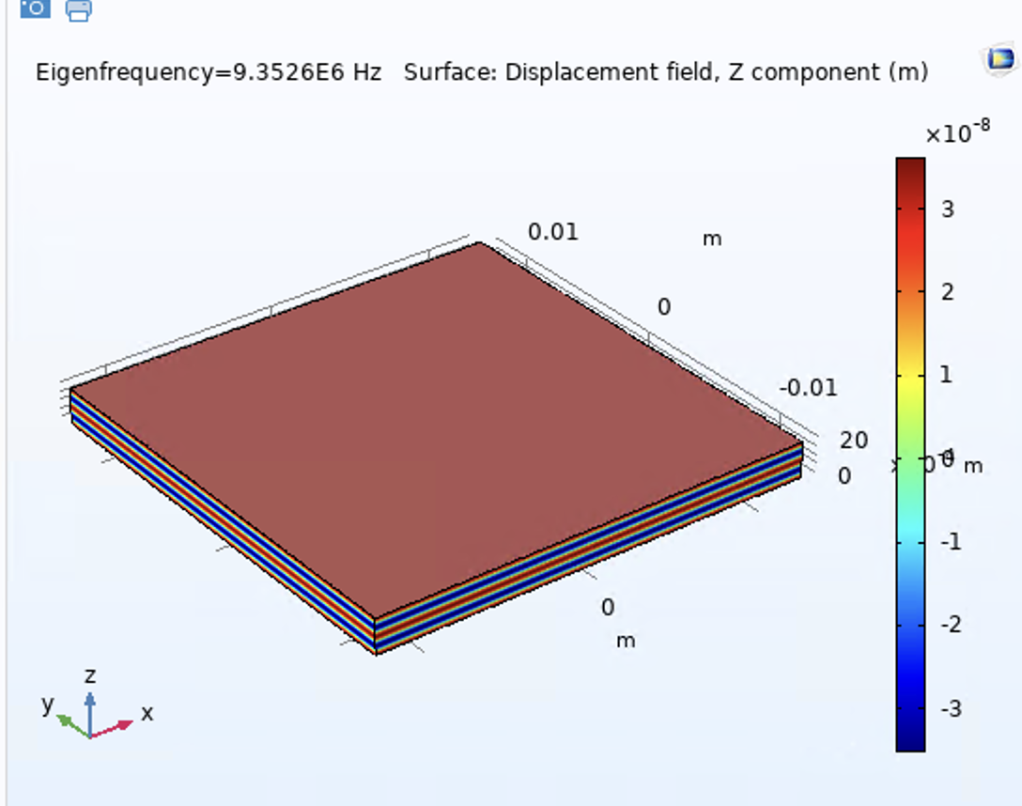
What are these modes?
Longitudinal
Transverse

Slide 28
Better Filter Justification

Slide 29
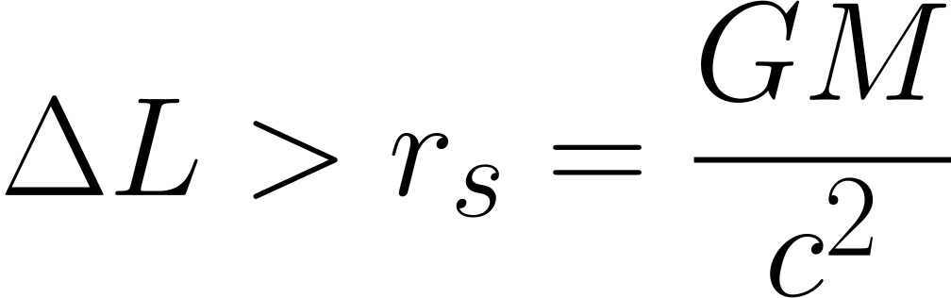
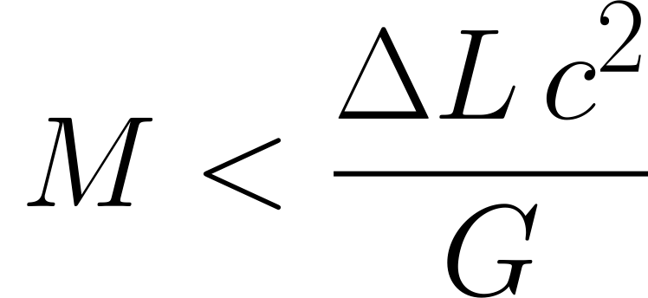

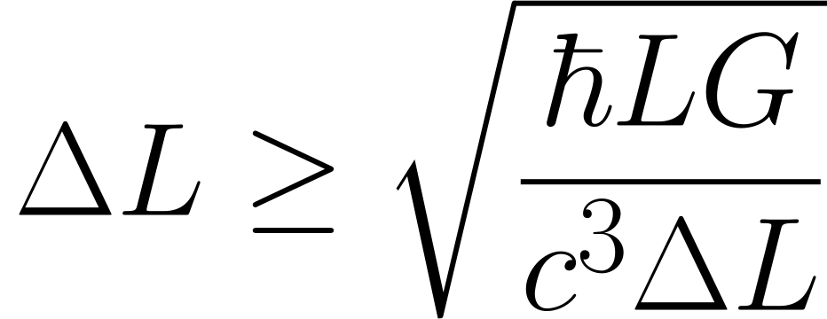
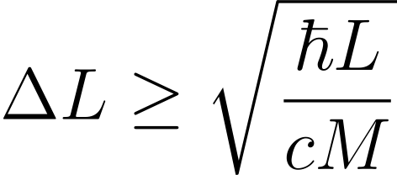
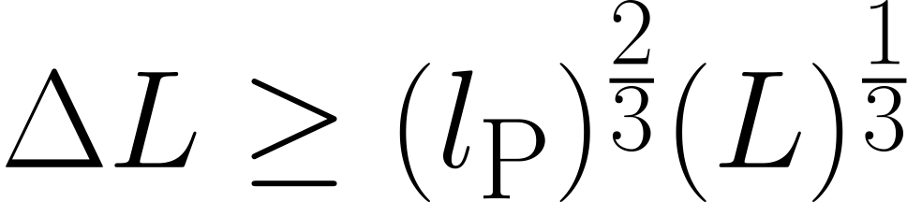
“Quantum Gravity” measurement limit
(‘Schwarzschild limit’)
(Standard Quantum Limit)
Jack Ng & Van Dam (1994)
Sander M. Vermeulen

Slide 30
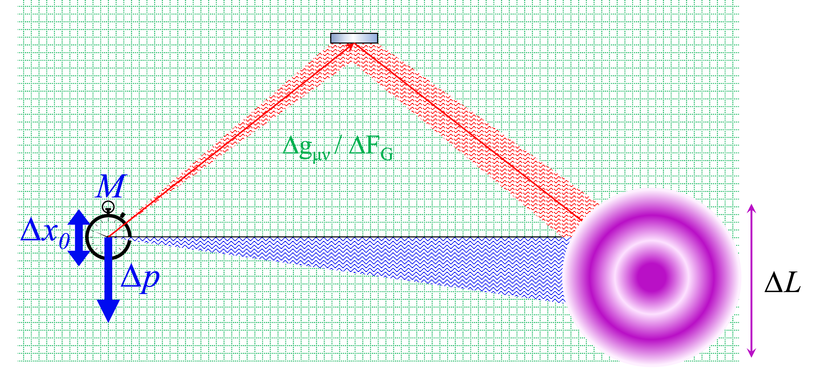
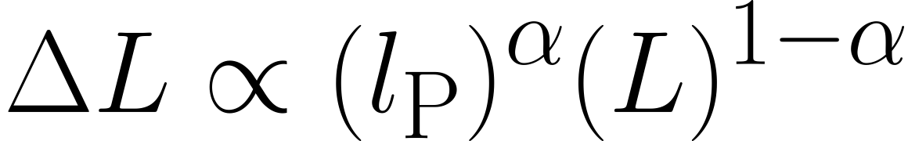

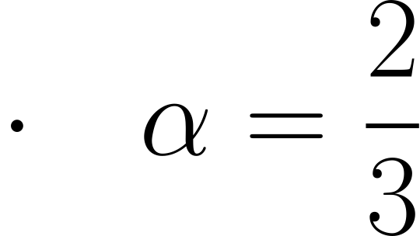
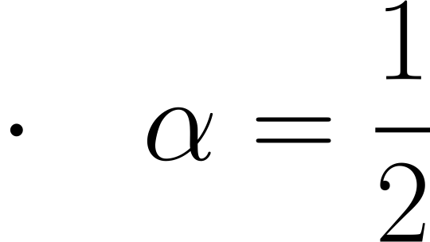
Limits on distance measurements from Quantum Gravity
EFT/String Theory/ LQG
Hoop Conjecture/ ‘Old’ holography (Y. Jack Ng & Van Dam)
Random walk, ‘New’ holography (Zurek & Verlinde, Hogan & Kwon)
Sander M. Vermeulen

Slide 31
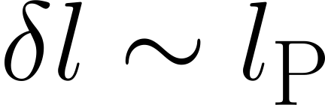
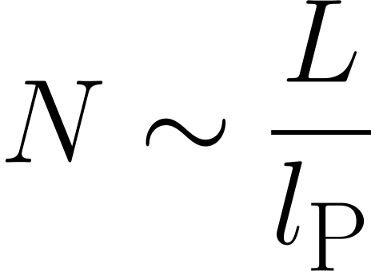
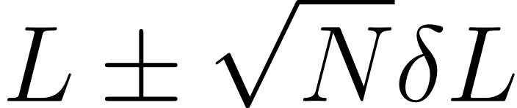
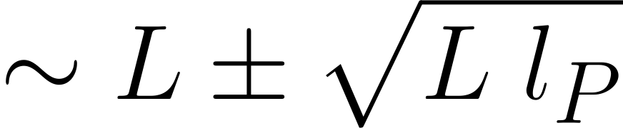
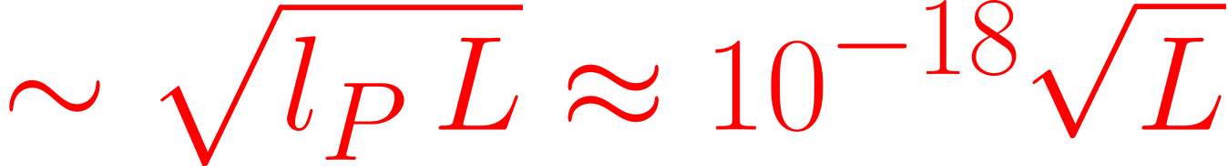
Light cone fluctuations accumulate like a random walk
time
Step size:
Number of steps
space
Total length:
Can we detect displacements m ?
Verlinde & Zurek (2019)
Hogan (2012)
Sander M. Vermeulen

